Slide 1
2 Measures of location and spread pg. 5
Statistics

Slide 2
Statistics
Quick review
$$mean=\frac{\text{∑}\text{x}\text{​}}{n}$$
The median is the middle value of a data set when it is arranged in ascending or descending order. If there's an even number of data points, the median is the average of the two middle numbers.
{1, 3, 5, 7, 9, 11}
The mode is the most repeated value.
The range is obtained using maximum value – minimum value

Slide 3
Statistics
Quick review
the sum of all data values
$$mean=\frac{\text{∑}\text{x}\text{​}}{n}$$
the number of data values.
The median is the middle value of a data set when it is arranged in ascending or descending order. If there's an even number of data points, the median is the average of the two middle numbers.
{1, 3, 5, 7, 9, 11}
The mode is the most repeated value.
The range is obtained using maximum value – minimum value

Slide 4
2 types of data
Statistics

Slide 5
Statistics

Slide 6
Statistics
{39,39,39,40,40,40,40,40,40,40,40,40,40,40,40,40,40,40,40,40,41,…..}

Slide 7
Statistics
>> Page 7.
{39,39,39,40,40,40,40,40,40,40,40,40,40,40,40,40,40,40,40,40,41,…..}

Slide 8
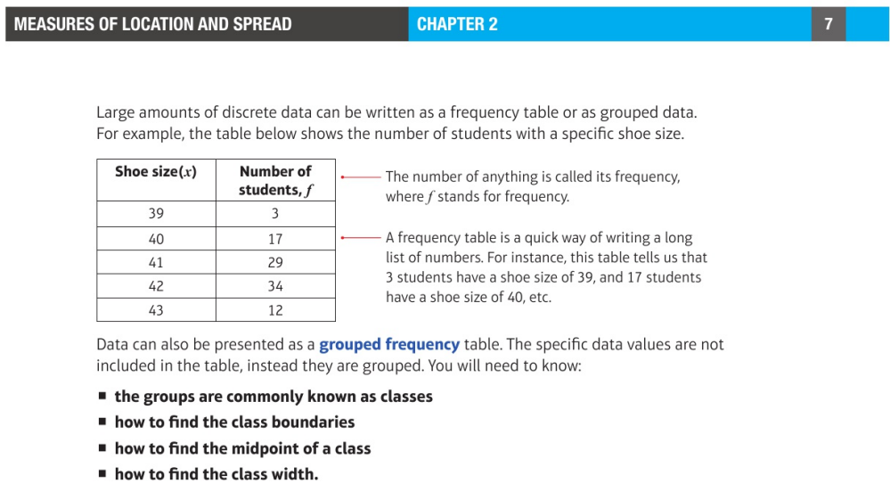
Statistics
Class Boundaries: These are the values halfway between the upper limit of one class and the lower limit of the next class.
Notes:
Classes are intervals in which data is grouped

Slide 9
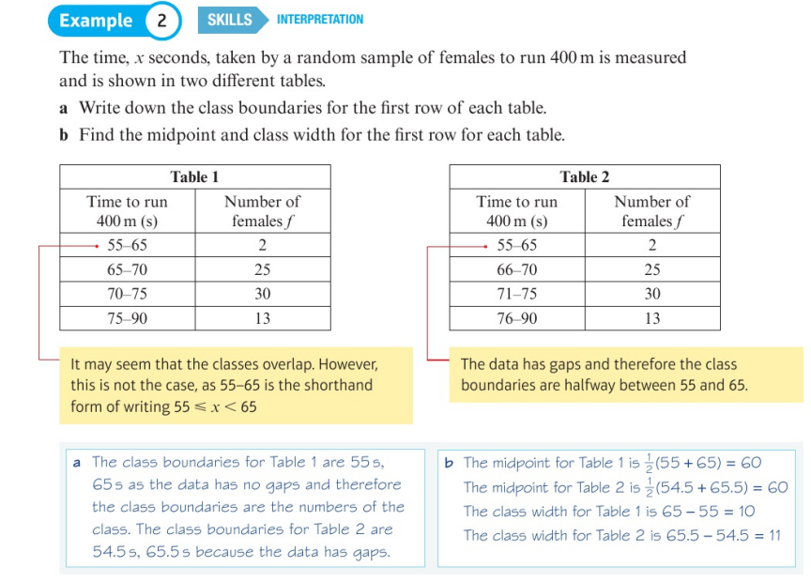
Statistics
Class Boundaries: These are the values halfway between the upper limit of one class and the lower limit of the next class.
Notes:
Classes are intervals in which data is grouped

Slide 10
Statistics
Combining means
$$x̄=\frac{n_{1}^{}{x̄}_{1}^{}+n_{2}^{}{x̄}_{2}^{}\text{​}}{n_{1}^{}+n_{2}^{}}$$
$x̄=\frac{\sum{xf}\text{​}}{\sum{f}}$ , wherein x = data values, f = frequency

Slide 11
Statistics
Pg 11
Obtaining the median value from a frequency table: use cumulative frequency
Cumulative frequency is the sum of the previous frequencies

Slide 12
Statistics
Pg 11
Breakdowns | Frequency | Cumulative frequency
0 | 8 | 8
1 | 11 | 19
2 | 12 | 31
3 | 3 | 34
4 | 1 | 35
5 | 1 | 36
Median is in $\frac{36+1}{2}$ = 18.5 , which has a value of 1

Slide 13
Statistics
Pg 11
Multiply each value x frequency (to obtain sum of data)
Divide by cumulative frequency
(0 x 8 ) + (1 x 11) + (2 x 12) + (3 x 3) + (4 x 1) + (5 x 1)
$$mean= \frac{53}{36}=1.47$$

Slide 14
Statistics
Pg 11
Multiply each value x frequency (to obtain sum of data)
Divide by cumulative frequency
(0 x 8 ) + (1 x 11) + (2 x 12) + (3 x 3) + (4 x 1) + (5 x 1)
$$mean= \frac{53}{36}=1.47$$

Slide 15
Statistics
Pg 11
$mean= \frac{Sum of values}{Total number of data }$.
(1 x 7) + (2 x p) + (3 x 2)
Cumulative frequency : 7 + p + 2 = 2 + p
$mean= \frac{1\left(7\right)+2\left(p\right)+3(2)}{9+p}$ , 1.5 = $\frac{1\left(7\right)+2\left(p\right)+3(2)}{9+p}$
1.5(9+p) = 7 + 2p + 6
13.5 + 1.5p = 13 + 2p
(subtract 1.5p from both sides)
0.5p = 0.5
P= 1

Slide 16
Statistics
Pg 11
$mean= \frac{Sum of values}{Total number of data }$.
(1 x 7) + (2 x p) + (3 x 2)
Cumulative frequency : 7 + p + 2 = 2 + p
$mean= \frac{1\left(7\right)+2\left(p\right)+3(2)}{9+p}$ , 1.5 = $\frac{1\left(7\right)+2\left(p\right)+3(2)}{9+p}$
1.5(9+p) = 7 + 2p + 6
13.5 + 1.5p = 13 + 2p
(subtract 1.5p from both sides)
0.5p = 0.5
P= 1

Slide 17
Statistics
Pg 12

Slide 18
Statistics
Pg 16

Slide 19
Measuring quartiles and percentiles
Statistics
Page. 13

Slide 20
Statistics
Steps to finding quartile or percentile:
Calculate the cumulative frequency (sum of all frequencies : N)
The position of the percentile $P= \frac{N+1}{\begin{aligned}100 \\ \end{aligned}}$
Find the class where the percentile P is located using:
$P=L+ \frac{(Desired position −F )}{f} x w$ L = lower boundary of the class F = cumulative frequency of the Previous class
f = frequency of the class containing the desired position
w = width of the class (largest – smallest values)

Slide 21
Statistics
Steps to finding quartile or percentile:
Calculate the cumulative frequency (sum of all frequencies : N)
The position of the percentile $P= \frac{N+1}{\begin{aligned}100 \\ \end{aligned}}$
Find the class where the percentile P is located using:
$P=L+ \frac{(Desired position −F )}{f} x w$ L = lower boundary of the class F = cumulative frequency of the Previous class
f = frequency of the class containing the desired position
w = width of the class (largest – smallest values)

